Slide 1

E-services tutorial
- How to report hazardous waste
This is a step-by-step tutorial on reporting hazardous waste to the waste register maintained by the Swedish Environmental Protection Agency.

Slide 2
Copyright notice to imagery
Photographic imagery in this presentation cannot be copied to or used in other presentations.
The copyright only applies to this presentation.

Slide 3
Step 1 log in

Slide 4
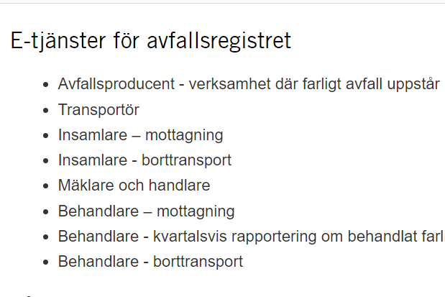
www.naturvardsverket.se/avfallsregister
(e-services for the waste register)
The easiest way to access the waste register is via:
www.naturvardsverket.se/
avfallsregister
Select the entry: ”Avfallsproducent – verksamhet där farligt avfall uppstår”
“Waste producer"

Slide 5

To access the e-service
To complete the login and access the e-service, you need to identify yourself with an e-identification.

Slide 6
Step 2 first questions

Slide 7
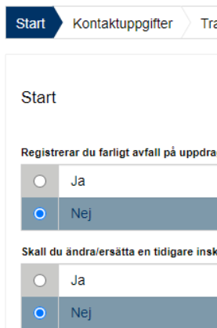
Start=First
The first step is to submit answers to identify if you are reporting as an agent or if you want to change a previously submitted document.
An agent is authorized to bring an action for another person

Slide 8
Step 3 contact details

Slide 9
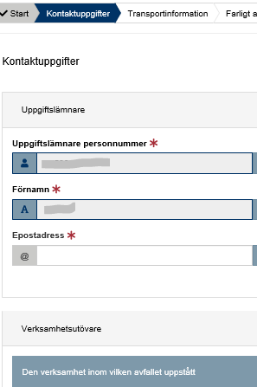
Contact details
Some details about you is filled in automatically and can’t be changed.
Submit details about the company/business you represent.
See example on next page.

Slide 10
Example with contact details
Uppgiftslämnare (Provider)
Uppgiftslämnares personnummer: * Provider’s social security number
19750201-1237
Förnamn: * First name
Efternamn: * Surname
Operators in this note are producers of hazardous waste. In other notes, operators are performers who professionally collect, transport or treat hazardous waste, or act as dealers and brokers of hazardous waste
Anders
Andersson
E-postadress * E-mail
Telefonnummer: * Telephone
anders.andersson@gmail.com
073-052 42 51
Verksamhetsutövare (Operator)
The CFAR number is a workplace's eight-digit identity that is assigned by Statistics Sweden's business register. If you do not know your CFAR number, you can search for it here: www.cfarnrsok.scb.se.
N.B. just applicible for Swedish businesses
Organisationsnummer/personnummer: *
Organization number/social security number
Verksamhetens namn: * Name of the company/business
Lenas måleri AB
568749-9631
E-postadress: * E-mail address
Kontaktperson: * Contact person
lena.andersson@maleriet.nu
Lena Andersson
Telefon: * Telephone
Verksamhetens CFAR-nummer: *
The business’ CFAR number
0721-583612
12345678

Slide 11
Step 4 carrier details

Slide 12
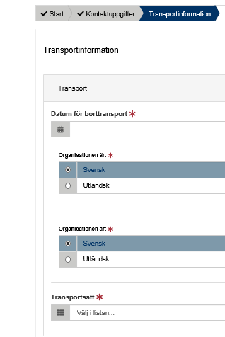
Carrier details
Here, details must be provided in three areas:
Details about the transportation
Place of origin of the waste
Destination
Examples on following pages

Slide 13

Provide information: carrier details
- Transportation
Transport (Carrier details)
Datum för borttransport: * Date of removal
2020-10-01
The legal person who receives the hazardous waste after shipment has been completed.
For example, a waste handler or waste collector.
Transportörens organisationsnummer/personnummer: *
The carrier's organization number / social security number
556343-2235
Mottagarens organisationsnummer/personnummer: *
The consignee’s organization number
568749-9631
Transportsätt: * Transportation
Vägtransport

Slide 14
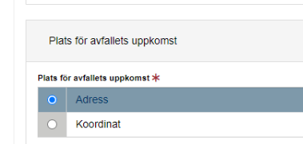
Provide information: carrier details
- Place of origin of the waste. Option 1 if address exist
Place of origin of the waste does not have to correspond to the address of the waste producer but can point to another place where work has been performed and where the waste thus arose.
Postadress: * Postal address
Virkesvägen 2
Postnummer: * Zip code
Postort: * Post office
120 30
Stockholm
Kommun: * Municipality
Stockholm (0180)

Slide 15

Provide information: carrier details
- Place of origin of the waste. Option 2 if address is missing, enter coordinates
Plats för avfallets uppkomst * Place of origin of the waste
Nordkoordinat (SWEREF 99 TM):* North coordinate
Ostkoordinat (SWEREF 99 TM):* East coordinate
5912938
18283472
Beskrivning: Description
Kommun* Municipality
Stockholm (0180)

Slide 16
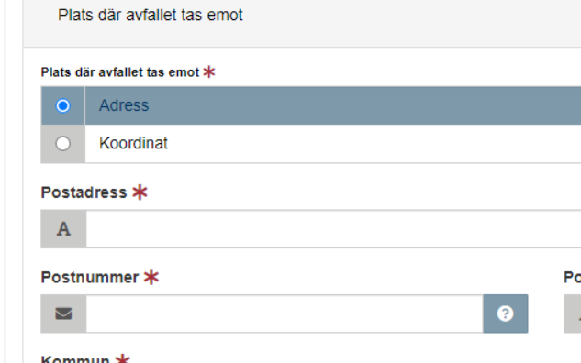
Provide information: carrier details
- Destination. Select option 1 if the address is available
The destination for the waste is where a new holder takes over the responsibility for the hazardous waste.
If address is missing, enter coordinates

Slide 17
Step 5 waste details

Slide 18
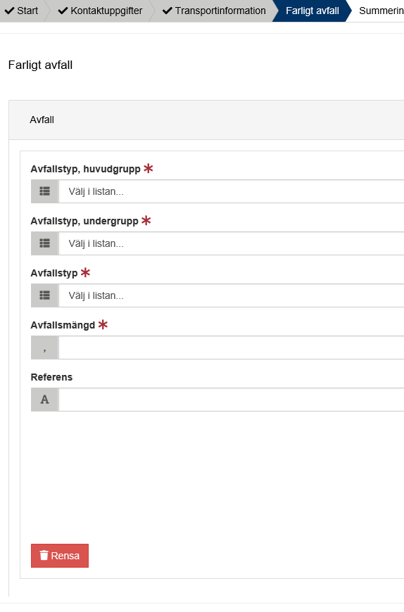
Hazardous waste
All details about the waste must be provided, such as the waste classification code and the amount of waste.
See example on next page.

Slide 19
Example of hazardous waste details
The waste classification codes are from the Waste Regulation (2020: 614) Read an introduction to waste classification
Farligt avfall, avfall Hazardous waste, waste
Avfallstyp, huvudgrupp: * Waste classification code, main group
08 Avfall från tillverkning, formulering, distribution och användning av ytbeläggningar (färg, lack och porslinsemalj), lim, …
Avfallstyp, undergrupp: * Waste classification code, sub group
0801 Avfall från tillverkning, formulering, distribution, användning och borttagning av färg och lack
Avfallstyp: * Waste classification code, six digit code
Here, the waste producer can e.g. enter his/her own code for the waste, Free comment
080111 Färg- och lackavfall som innehåller organiska lösningsmedel eller andra farliga ämnen
Avfallsmängd (kg):* Amount of waste in kilogram
KG
100
Referens: Reference
Valfri text

Slide 20
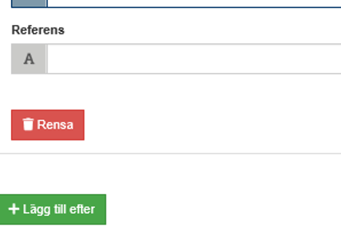
Add more hazardous waste
Select “Lägg till efter“ to add information about other hazardous waste that is transported at the same time.

Slide 21
Step 6 summary & review

Slide 22
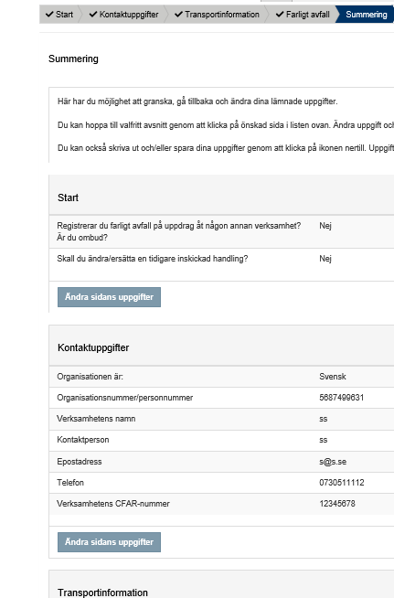
Summary
Review the information.
You can reach different sections to change details by selecting “Ändra sidans uppgifter”.
After changing details in a previous section, you can go directly to this summary.

Slide 23
Step 7 almost done!

Slide 24
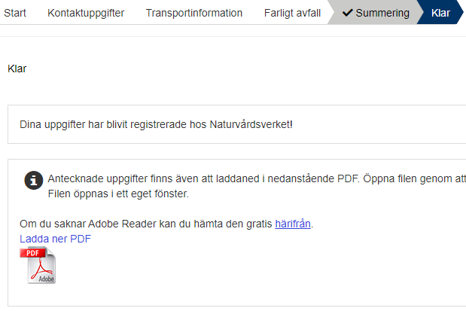
The note is submitted
Thank you for your registration
Keep the registration ID, AvfallsID (found in the pdf file), to be able to revise the registration later.
Log out of the e-service
What happens next? When the carrier has reached the destination site, the waste is checked and measured at the facility. Sometimes analytical samples are taken to find out the components. Thereafter, the waste is treated in accordance to relevant methods.

Slide 25
How do I change an earlier registration?

Slide 26
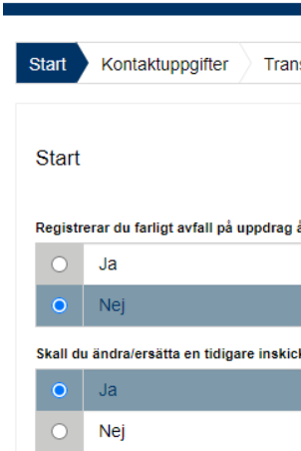
Start
You can edit a submitted note by replacing it. To succeed you need to know the note’s registration ID (avfallsID).
Select “ja“ (yes) at the Start question “Ska du ändra/ersätta en tidigare inskickad handling?”
Enter the former “avfallsID” and enter all correct details
The new note replaces the previous one and gets a new registration ID (avfallsID)
See example on next page.

Slide 27
Example of replacing a previous note
Farligt avfall, avfall Hazardous waste, waste
The waste classification codes are from the Waste Regulation (2020: 614) Read an introduction to waste classification
AvfallsId som ska ändras: * Registration ID to be replaced
055089d1-81c8-4217-9737-aea00685f1f7
Avfallstyp, huvudgrupp: * Waste classification code, main group
08 Avfall från tillverkning, formulering, distribution och användning av ytbeläggningar (färg, lack och porslinsemalj), lim, …
Avfallstyp, undergrupp: * Waste classification code, sub group
0801 Avfall från tillverkning, formulering, distribution, användning och borttagning av färg och lack
Avfallstyp * Waste classification code, six digit code
080111 Färg- och lackavfall som innehåller organiska lösningsmedel eller andra farliga ämnen
Here, the waste producer can e.g. enter his/her own code for the waste, Free comment
Avfallsmängd (kg):* Amount of waste in kilogram
KG
100
Referens: Reference
Valfri text

