Slide 1
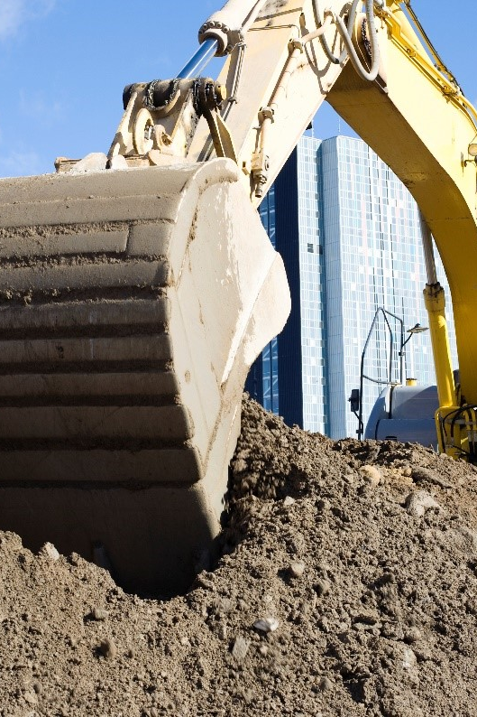
E-services tutorial
- How to report hazardous waste
This is a step-by-step tutorial on reporting hazardous waste to the waste register maintained by the Swedish Environmental Protection Agency.
Reporting is done quarterly.

Slide 2
Copyright notice to imagery
Photographic imagery in this presentation cannot be copied to or used in other presentations.
The copyright only applies to this presentation.

Slide 3
Step 1 log in

Slide 4
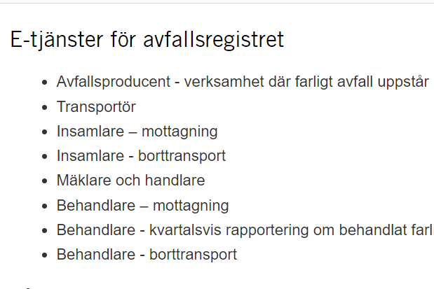
www.naturvardsverket.se/avfallsregister
(e-services for the waste register)
The easiest way to access the waste register is via:
www.naturvardsverket.se/
avfallsregister
Select the entry:
”Behandlare – kvartalsvis rapportering om behandlat farligt avfall”
”Waste treatment facility – reporting waste treatment quarterly”

Slide 5

To access the e-service
To complete the login and access the e-service, you need to identify yourself with an e-identification.

Slide 6
Step 2 first questions

Slide 7
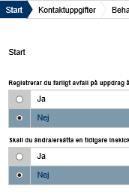
Start=First
The first step is to submit answers to identify if you are reporting as an agent or want to change a previously submitted document.
An agent is authorized to bring an action for another person.

Slide 8
Step 3 contact details

Slide 9
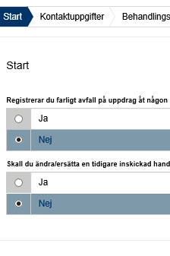
Contact details
Some details about you is filled in automatically and can’t be changed.
Submit details about the company/business you represent.
See example on next page.

Slide 10


Example with contact details
Uppgiftslämnare (Provider)
Uppgiftslämnares personnummer: * Provider’s social security number
19670416-3085
Operators in this note treat hazardous waste. In other notes, operators are producers of hazardous waste, performers who professionally ship, collect, or act as dealers and brokers of hazardous waste
Förnamn: * First name
Efternamn: * Surname
Axelina
Bruhn
E-posdresst: * E-mail
Telefonnummer : * Telephone
axelina.bruhn@avaretur.se
072-348 76 53
Verksamhetsutövare (Operator)
Organisationsnummer/personnummer: *
Organization number/social security number
578654-3214
Verksamhetens namn: * Name of the company
Kontaktperson: * Contact person
ÅVA Retur AB
Tova Strand
E-postadress: * E-mail
Telefonnummer: * Telephone
tova.strand@avretur.se
072-321 45 78

Slide 11
Step 4 waste treatment details

Slide 12
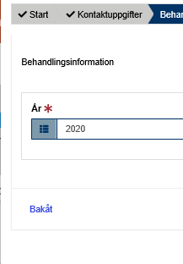
Waste treatment – details
Provide the year and quarter for reporting.

Slide 13

Provide information: waste treatment
- Reporting
Behandling Waste treatment
År: * Year
Kvartal: * Quarter
2020
Kvartal 2

Slide 14
Step 5 waste details

Slide 15
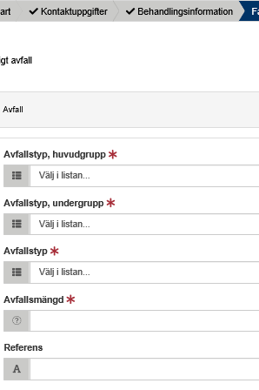
Hazardous waste
All details about the waste must be provided, such as the waste classification code and the amount of waste.
See example on next page.

Slide 16

Example of hazardous waste details
The waste classification codes are from the Waste Regulation (2020: 614) Read an introduction to waste classification
Farligt avfall, avfall Hazardous waste, waste
Avfallstyp, huvudgrupp: * Waste classification code, main group
16 Avfall som inte anges på annan plats i förteckningen
Avfallstyp, undergrupp: * Waste classification code, sub group
1601 Uttjänta fordon från olika transportslag (även maskiner som inte är avsedda att användas på väg) och avfall från…
Avfallstyp: * Waste classification code, six digit code
Here, the waste treatment
can e.g. enter an own code for the waste. Free comment.
160104 Uttjänta fordon
Avfallsmängd (kg ):* Amount of waste in kilogram
KG
6756
Referens: Reference

Slide 17

Example of hazardous waste details treatment method and results
Farligt avfall, avfall Hazardous waste, waste
Behandlingsmetod: * Waste treatment method
R9 Återvinning av katalysatorkomponenter
Underkod: * Sub code
(A) Konentionell materialåtervinning
Mängd farligt avfall som blivit icke-farligt avfall : *
Amount of hazardous waste that has become non-hazardous waste
KG
6
Mängd produkter/material som upphört med att vara farligt avfall : *
Amount of products / materials that have ceased to be hazardous waste
KG
569

Slide 18
Example of details
- waste oil recovery
Typ av resultat av återvinning av spillolja Results from recycling the waste oil
Specifikation (om det är typ av resultat) Specification
Mängd regenerering Amount of regeneration
KG
Mängd annan materialåtervinning Amount of other material recycling
KG
Mängd energiåtervinning Amount of energy recovering
KG
Mängd bortskaffande Amount of disposal
KG

Slide 19
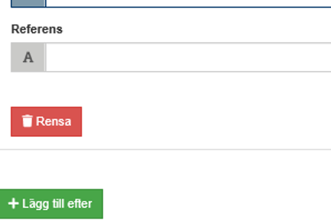
Add more hazardous waste
Select “Lägg till efter“ to add information about other hazardous waste that will be reported in the same note

Slide 20
Step 6 summary & review

Slide 21
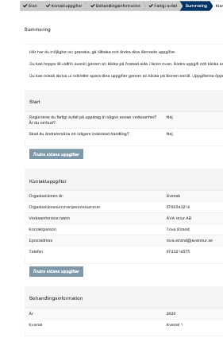
Summary
Review the information.
You can reach different sections to change details by selecting “Ändra sidans uppgifter”.
After changing details in a previous section, you can go directly to this summary.

Slide 22
Step 7 almost done!

Slide 23
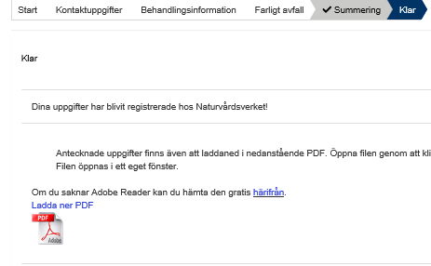
The note is submitted
Thank you for your registration
Keep the registration ID, AvfallsID (found in the pdf file), to be able to revise the registration later.
Log out of the e-service

Slide 24
How do I change an earlier registration?

Slide 25
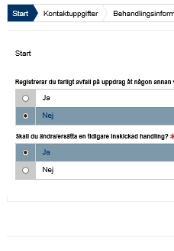
Start
You can edit a submitted note by replacing it. To succeed you need to know the note’s registration ID (avfallsID).
Select “ja“ (yes) at the Start question “Ska du ändra/ersätta en tidigare inskickad handling?”
Enter the former “avfallsID” and enter all correct details
The new note replaces the previous one and gets a new registration ID (avfallsID)
See example on next page.

Slide 26
Example of replacing a previous note
Farligt avfall, avfall Hazardous waste, waste
The waste classification codes are from the Waste Regulation (2020: 614) Read an introduction to waste classification
AvfallsId som ska ändras: * Registration ID to be replaced
6c104db7-8f55-4ea0-86c8-1cf2a4f26361
Avfallstyp, huvudgrupp: * Waste classification code, main group
16 Avfall som inte anges på annan plats i förteckningen
Avfallstyp, undergrupp: * Waste classification code, sub group
1601 Uttjänta fordon från olika transportslag (även maskiner som inte är avsedda att användas på väg) och avfall från…
Avfallstyp: * Waste classification code, six digit code
160104 Uttjänta fordon
Avfallsmängd (kg): * Amount of waste in kilogram
Here, the waste treatment can e.g. enter an own code for the waste. Free comment.
KG
6756
Referens: Reference
Valfri text

