Slide 1

E-services tutorial
- How to report hazardous waste
This is a step-by-step tutorial on reporting hazardous waste to the waste register maintained by the Swedish Environmental Protection Agency.

Slide 2
Copyright notice to imagery
Photographic imagery in this presentation cannot be copied to or used in other presentations.
The copyright only applies to this presentation.

Slide 3
Step 1 log in

Slide 4
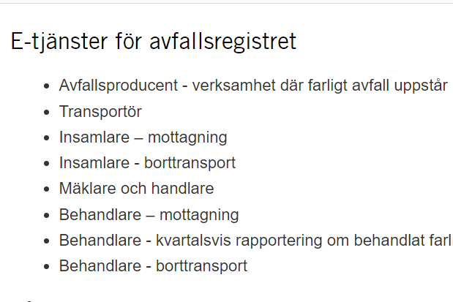
www.naturvardsverket.se/avfallsregister
(e-services for the waste register)
The easiest way to access the waste register is via:
www.naturvardsverket.se/
avfallsregister
Select the entry:
” Mäklare och handlare”
”Waste broker or dealer”

Slide 5

To access the e-service
To complete the login and access the e-service, you need to identify yourself with an e-identification.

Slide 6
Step 2 first questions

Slide 7
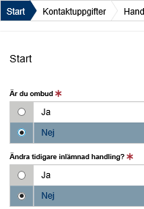
Start=First
The first step is to submit answers to identify if you are reporting as an agent or want to change a previously submitted document
An agent is authorized to bring an action for another person.

Slide 8
Step 3 contact details

Slide 9
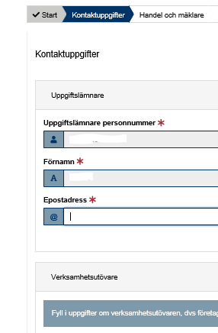

Contact details
Some details about you is filled in automatically and can’t be changed.
Submit details about the organization/business you represent.
See example on next page.

Slide 10

Example with contact details
Uppgiftslämnare (Provider)
Uppgiftslämnares personnummer: * Provider’s social security number
19900924-1382
Operators in this note are brokers/dealers of hazardous waste. In other notes, operators are producers of hazardous waste, performers who professionally collect, ship or treat hazardous waste
Förnamn: * First name
Efternamn: * Surname
Eva-Marie
Welin
E-postadress: * E-mail
Telefonnummer: * Telephone
eva-marie.welin@hanssonshandel.se
018-159 46 25
Verksamhetsutövare
Organisationsnummer/personnummer: *
Organization number/social security number
567437-8905
Verksamhetens namn: * Name of the company
Kontaktperson: * Contact person
Hanssons Handel AB
Eva-Marie Welin
E-postadress * E-mail
Telefonnummer: * Telephone
eva-marie.welin@hanssonshandel.se
018-159 46 25

Slide 11
Step 4 dealer and broker details

Slide 12
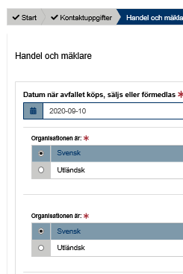
Trading and brokerage details
Here, details must be provided for:
Date when the waste is sold, bought or brokered
Previous and new holder

Slide 13
Step 5 waste details

Slide 14

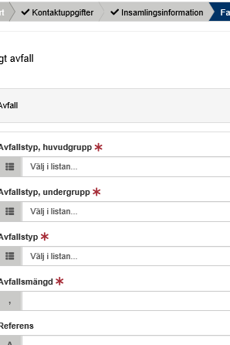
Hazardous waste
All details about the waste must be provided, such as the waste classification code and the amount of waste.
See example on next page.

Slide 15
Example of hazardous waste details
The waste classification codes are from the Waste Regulation (2020: 614) Read an introduction to waste classification
Farligt avfall, avfall Hazardous waste, waste
Avfallstyp, huvudgrupp: * Waste classification code, main group
13 Oljeavfall och avfall från flytande bränslen (utom ätliga oljor 05 och 12)
Avfallstyp, undergrupp: * Waste classification code, sub group
1302 Motorolje-, transmissionsolje- och smörjoljeavfall
Avfallstyp: * Waste classification code, six digit code
Here, the waste dealer/broker can e.g. enter his/her own code for the waste. Free comment.
130204 Mineralbaserade klorerade motor-, transmissions- och smörjoljor
Avfallsmängd (kg): * Amount of waste in kilogram
KG
850
Referens: Reference

Slide 16
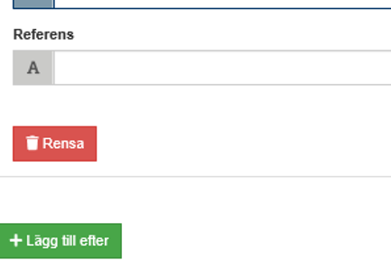
Add more hazardous waste
Select “Lägg till efter“ to add information about other hazardous waste that will be bought, sold or brokered at the same time.

Slide 17
Step 6 summary & review

Slide 18
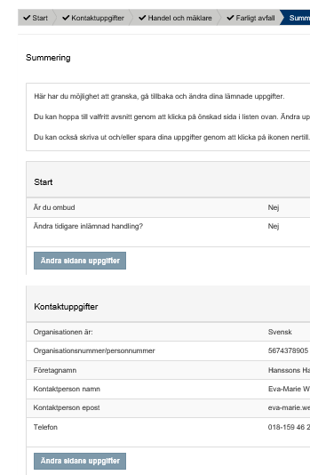
Summary
Review the information.
You can reach different sections to change details by selecting “Ändra sidans uppgifter”.
After changing details in a previous section, you can go directly to this summary.

Slide 19
Step 7 almost done!

Slide 20
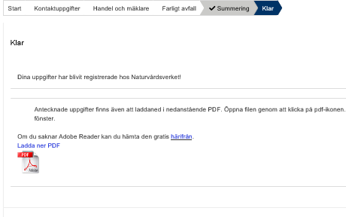
The note is submitted
Thank you for your registration
Keep the registration ID, AvfallsID (found in the pdf file), to be able to revise the registration later.
Log out of the e-service

Slide 21
How do I change an earlier registration?

Slide 22
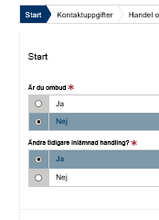
Start
You can edit a submitted note by replacing it. To succeed you need to know the note’s registration ID (avfallsID).
Select “ja“ (yes) at the Start question “Ska du ändra/ersätta en tidigare inskickad handling?”
Enter the former “avfallsID” and enter all correct details
The new note replaces the previous one and gets a new registration ID (avfallsID)
See example on next page.

Slide 23
Example of replacing a previous note
Farligt avfall, avfall Hazardous waste, waste
The waste classification codes are from the Waste Regulation (2020: 614) Read an introduction to waste classification
AvfallsId som ska ändras: * Registration ID to be replaced
61ee0685-714f-576c-afb6-2d0ce1O6c52d2
Avfallstyp, huvudgrupp: * Waste classification code, main group
13 Oljeavfall och avfall från flytande bränslen (utom ätliga oljor 05 och 12)
Avfallstyp, undergrupp: * Waste classification code, sub group
1302 Motorolje-, transmissionsolje- och smörjoljeavfall
Avfallstyp: * Waste classification code, six digit code
130204 Mineralbaserade klorerade motor-, transmissions- och smörjoljor
Avfallsmängd (kg): * Amount of waste in kilogram
Here, the waste dealer/broker can e.g. enter his/her own code for the waste. Free comment.
KG
850
Referens: Reference

