Slide 1

E-services tutorial
- How to report hazardous waste
This is a step-by-step tutorial on reporting hazardous waste to the waste register maintained by the Swedish Environmental Protection Agency.

Slide 2
Copyright notice to imagery
Photographic imagery in this presentation cannot be copied to or used in other presentations.
The copyright only applies to this presentation.

Slide 3
Step 1 log in

Slide 4
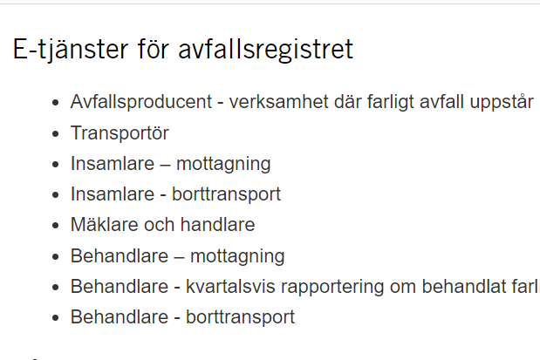
www.naturvardsverket.se/avfallsregister
(e-services for the waste register)
The easiest way to access the waste register is via:
www.naturvardsverket.se/
avfallsregister
Select the entry:
”Behandlare - mottagning”
”Waste treatment facility – reporting as a consignee”

Slide 5

To access the e-service
To complete the login and access the e-service, you need to identify yourself with an e-identification.

Slide 6
Step 2 first questions

Slide 7
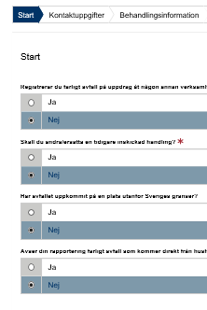
Start=First
The first step is to submit answers to identify if
you are reporting as an agent
want to change a previously submitted document.
the transport starts outside the Swedish border or if the hazardous waste comes directly from households
An agent is authorized to bring an action for another person.

Slide 8
Step 3 contact details

Slide 9
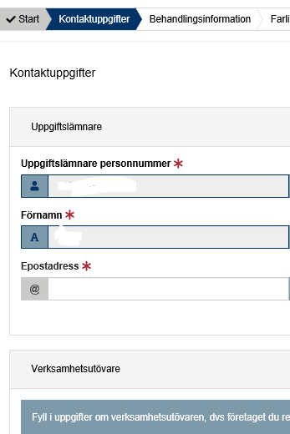
Contact details
Some details about you is filled in automatically and can’t be changed.
Submit details about the company/business you represent.
See example on next page.

Slide 10


Example with contact details
Uppgiftslämnare (Provider)
Uppgiftslämnares personnummer: * Provider’s social security number
19670416-3085
Operators in this note treat hazardous waste. In other notes, operators are producers of hazardous waste, performers who professionally ship, collect, or act as dealers and brokers of hazardous waste
Förnamn: * First name
Efternamn: * Surname
Axelina
Bruhn
E-postadress: * E-mail
Telefonnummer : * Telephone
axelina.bruhn@avaretur.se
072-348 76 53
Verksamhetsutövare (Operator)
Organisationsnummer/personnummer: *
Organization number/social security number
578654-3214
Verksamhetens namn: * Name of the company
Kontaktperson: * Contact person
ÅVA Retur AB
Tova Strand
E-postadress: * E-mail
Telefonnummer: * Telephone
tova.strand@avretur.se
072-321 45 78

Slide 11
Step 4 consignee details

Slide 12
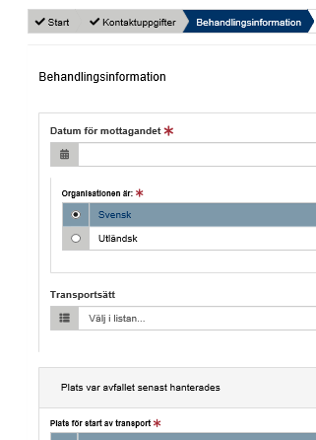
Consignee details
Here, details must be provided in three areas:
Consignment details
Place where the waste was managed last
Place where the waste will be treated
Example on following pages.

Slide 13

Provide information as a consignee
- Waste treatment
Behandling Waste treatment
The legal person who previously held the hazardous waste.
For example, a waste producer
Datum för mottagandet: * Date of receivement
2020-10-10
Tidigare innehavare organisationsnummer/personnummer: *
Previous holder’s organization number
556435-2341
Transportsätt: * Transportation
Vägtransport

Slide 14
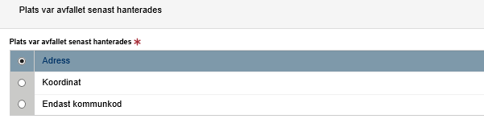
Provide information as a consignee
- Place where the waste was managed last. Option 1 if address exists
Postadress: * Postal address
Skogsvägen 3
Postnummer: * Zip code
Postort: * Post office
84301
Bräcke
Kommun: * Municipality
Bräcke (2305)

Slide 15
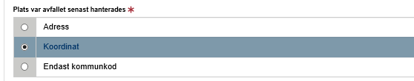
Provide information as a consignee
- Place where the waste was managed last. Option 2 if address is missing - enter coordinates
Nordkoordinat (SWEREF 99 TM):* North coordinate
Ostkoordinat (SWEREF 99 TM):* East coordinate
15,4289
62,7537
Beskrivning: Description
Kommun* Municipality
Bräcke (2305)

Slide 16
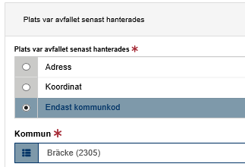
Provide information as a consignee
- Place where the waste was managed last. Option 3 if address is missing - enter municipal code
The municipal code is stated in cases where the municipality manages waste from households or when the producer is unknown, such as dumping.

Slide 17
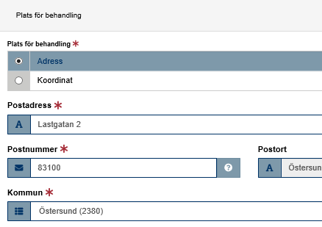
Provide information as a consignee
- Place where the waste will be treated. Option 1 if address exists.
The place where the waste will be treated
If address is missing, state coordinates

Slide 18
Step 5 waste details

Slide 19
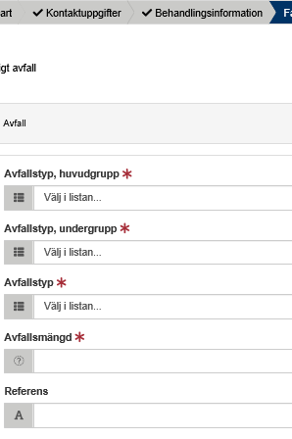
Hazardous waste
All details about the waste must be provided, such as the waste classification code and the amount of waste.
See example on next page.

Slide 20

Example of hazardous waste details
The waste classification codes are from the Waste Regulation (2020: 614) Read an introduction to waste classification
Farligt avfall, avfall Hazardous waste, waste
Avfallstyp, huvudgrupp: * Waste classification code, main group
16 Avfall som inte anges på annan plats i förteckningen
Avfallstyp, undergrupp: * Waste classification code, sub group
1601 Uttjänta fordon från olika transportslag (även maskiner som inte är avsedda att användas på väg) och avfall från…
Avfallstyp: * Waste classification code, six digit code
Here, the waste treatment
can e.g. enter an own code for the waste. Free comment.
160104 Uttjänta fordon
Avfallsmängd (kg ):* Amount of waste in kilogram
KG
6756
Referens: Reference

Slide 21
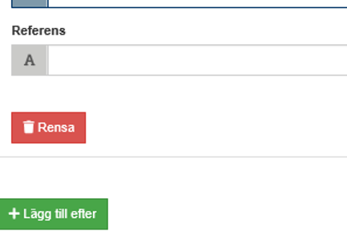
Add more hazardous waste
Select “Lägg till efter“ to add information about other hazardous waste that has been received in the same shipment.

Slide 22
Step 6 summary & review

Slide 23
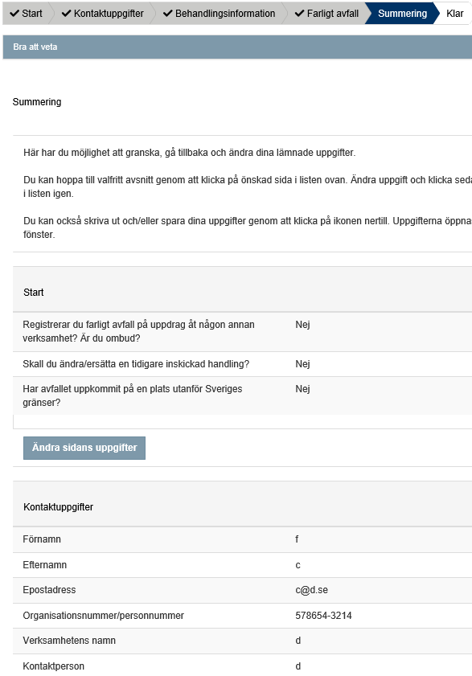
Summary
Review the information.
You can reach different sections to change details by selecting “Ändra sidans uppgifter”.
After changing details in a previous section, you can go directly to this summary.

Slide 24
Step 7 almost done!

Slide 25
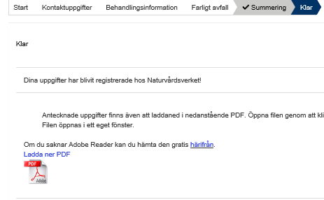
The note is submitted
Thank you for your registration
Keep the registration ID, AvfallsID (found in the pdf file), to be able to revise the registration later.
Log out of the e-service

Slide 26
How do I change an earlier registration?

Slide 27
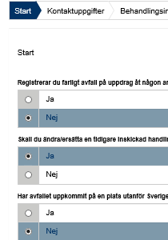
Start
You can edit a submitted note by replacing it. To succeed you need to know the note’s registration ID (avfallsID).
Select “ja“ (yes) at the Start question “Ska du ändra/ersätta en tidigare inskickad handling?”
Enter the former “avfallsID” and enter all correct details
The new note replaces the previous one and gets a new registration ID (avfallsID)
See example on next page.

Slide 28
Example of replacing a previous note
Farligt avfall, avfall Hazardous waste, waste
The waste classification codes are from the Waste Regulation (2020: 614) Read an introduction to waste classification
AvfallsId som ska ändras: * Registration ID to be replaced
du17ab61-3g5e-17rs-3791-06aa85df1f7
Avfallstyp, huvudgrupp: * Waste classification code, main group
16 Avfall som inte anges på annan plats i förteckningen
Avfallstyp, undergrupp: * Waste classification code, sub group
1601 Uttjänta fordon från olika transportslag (även maskiner som inte är avsedda att användas på väg) och avfall från…
Avfallstyp: * Waste classification code, six digit code
160104 Uttjänta fordon
Here, the waste treatment can e.g. enter an own code for the waste. Free comment.
Avfallsmängd (kg): * Amount of waste in kilogram
KG
6756
Referens: Reference
Valfri text

