Slide 1
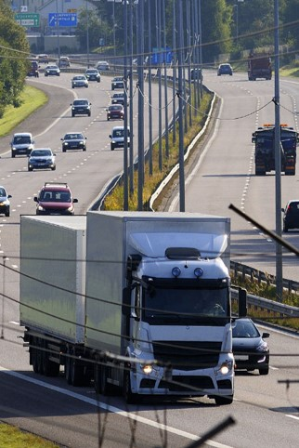
E-services tutorial
- How to report hazardous waste
This is a step-by-step tutorial on reporting hazardous waste to the waste register maintained by the Swedish Environmental Protection Agency.

Slide 2
Copyright notice to imagery
Photographic imagery in this presentation cannot be copied to or used in other presentations.
The copyright only applies to this presentation.

Slide 3
Step 1 log in

Slide 4
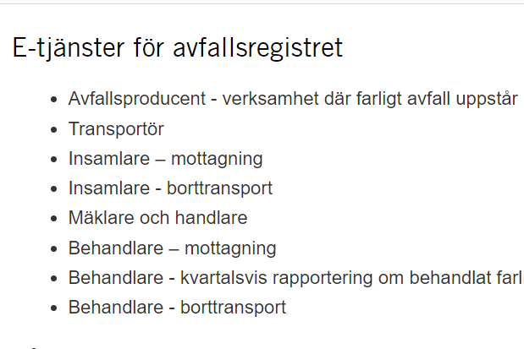
www.naturvardsverket.se/avfallsregister
(e-services for the waste register)
The easiest way to access the waste register is via:
www.naturvardsverket.se/
avfallsregister
Select the entry:
”Insamlare - borttransport”
”Collector – reporting at removal”

Slide 5

To access the e-service
To complete the login and access the e-service, you need to identify yourself with an e-identification.

Slide 6
Step 2 first questions

Slide 7
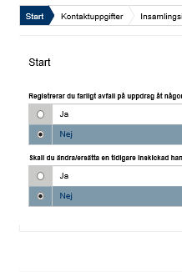
Start=First
The first step is to submit answers to identify if you are reporting as an agent, for a municipality or want to change a previously submitted document
An agent is authorized to bring an action for another person.

Slide 8
Step 3 contact details

Slide 9
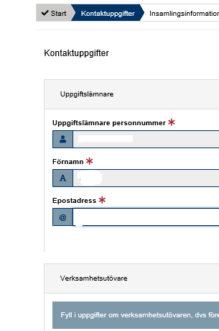
Contact details
Some details about you is filled in automatically and can’t be changed.
Submit details about the company/business you represent.
See example on next page.

Slide 10


Example with contact details
Uppgiftslämnare (Provider)
Uppgiftslämnares personnummer: * Provider’s social security number
19631221-6861
Operators in this note are collector’s of hazardous waste. In other notes, operators are producers of hazardous waste, performers who professionally ship or treat hazardous waste, or act as dealers and brokers of hazardous waste
Förnamn: * First name
Efternamn: * Surname
Gustav
Krantz
E-postadress: * E-mail
Telefonnummer: * Telephone
gustav.krantz@samlain.se
070-456 78 94
Verksamhetsutövare (Operator)
Organisationsnummer/personnummer: *
Organization number/social security number
555678-3578
Verksamhetens namn: * Name of the company
Kontaktperson: * Contact person
SamlaIn AB
Karin Olsson
E-postadress * E-mail
Telefonnummer: * Telephone
karin.olsson@samlain.se
072-238 79 092

Slide 11
Step 4 transportation details
Notes:
Borttransport handlar detta steg om.

Slide 12
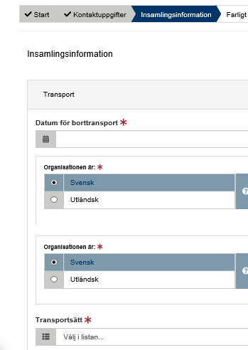
Transportation details
Here, details must be provided in three areas:
Details about the removal
Place where the waste was managed last
Place where the waste will be managed next
Examples on following pages.

Slide 13
Provide information: transportation details
- Collector – reporting at removal
Transport Transportation
Datum för borttransport: * Date of removal
2020-10-09
The legal person who receives the hazardous waste after shipment has been completed.
For example, a waste handler or waste dealer.
Transportörens organisationsnummer/personnummer: *
The carrier's organization number / social security number
5525413695
Mottagarens organisationsnummer/personnummer: *
The consignee's organization number
5698745899
Transportsätt: * Transportation
Vägtransport

Slide 14
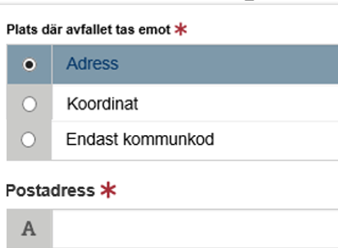
Provide information: transportation details
- Place where the waste will be managed. Option 1 if address exists.
The place where the waste will be managed is where a new holder, for example a waste broker or waste treatment facility, takes over responsibility for the hazardous waste
If address is missing, state coordinates or municipality code.

Slide 15
Step 5 waste details

Slide 16
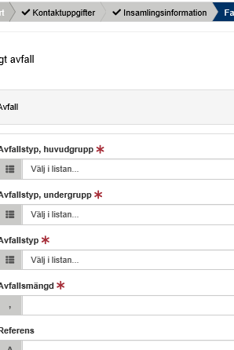
Hazardous waste
All details about the waste must be provided, such as the waste classification code and the amount of waste.
See example on next page.

Slide 17
Example of hazardous waste details
The waste classification codes are from the Waste Regulation (2020: 614) Read an introduction to waste classification
Farligt avfall, avfall Hazardous waste, waste
Avfallstyp, huvudgrupp: * Waste classification code, main group
17 Bygg- och rivningsavfall (även uppgrävda massor från förorenade områden)
Avfallstyp, undergrupp: * Waste classification code, sub group
1706 Isolermaterial och byggmaterial som innehåller asbest
Avfallstyp: * Waste classification code, six digit code
170605 Byggmaterial som innehåller asbest (4)
Here, the waste collector can e.g. enter his/her own code for the waste. Free comment.
Avfallsmängd (kg): * Amount of waste in kilogram
KG
1456
Referens: Reference

Slide 18
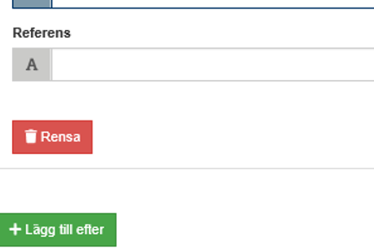
Add more hazardous waste
Select “Lägg till efter“ to add information about other hazardous waste that will be transported by the same transport.

Slide 19
Step 6 summary & review

Slide 20
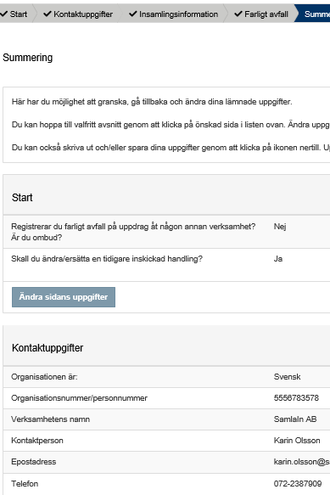
Summary
Review the information.
You can reach different sections to change details by selecting “Ändra sidans uppgifter”.
After changing details in a previous section, you can go directly to this summary.

Slide 21
Step 7 almost done!

Slide 22
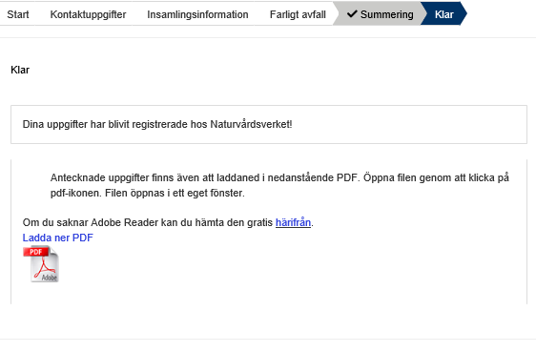
The note is submitted
Thank you for your registration
Keep the registration ID, AvfallsID (found in the pdf file), to be able to revise the registration later.
Log out of the e-service

Slide 23
How do I change an earlier registration?

Slide 24
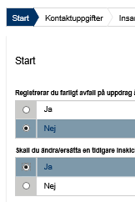
Start
You can edit a submitted note by replacing it. To succeed you need to know the note’s registration ID (avfallsID).
Select “ja“ (yes) at the Start question “Ska du ändra/ersätta en tidigare inskickad handling?”
Enter the former “avfallsID” and enter all correct details
The new note replaces the previous one and gets a new registration ID (avfallsID)
See example on next page.

Slide 25
Example of replacing a previous note
Farligt avfall, avfall Hazardous waste, waste
The waste classification codes are from the Waste Regulation (2020: 614) Read an introduction to waste classification
AvfallsId som ska ändras: * Registration ID to be replaced
053489d1-89c8-4227-9567-aea0bgg5f1f7
Avfallstyp, huvudgrupp: * Waste classification code, main group
17 Bygg- och rivningsavfall (även uppgrävda massor från förorenade områden)
Avfallstyp, undergrupp: * Waste classification code, sub group
1706 Isolermaterial och byggmaterial som innehåller asbest
Avfallstyp: * Waste classification code, six digit code
170605 Byggmaterial som innehåller asbest (4)
Here, the waste collector can e.g. enter his/her own code for the waste. Free comment.
Avfallsmängd (kg ): * Amount of waste in kilogram
KG
1456
Referens: Reference

