Slide 1
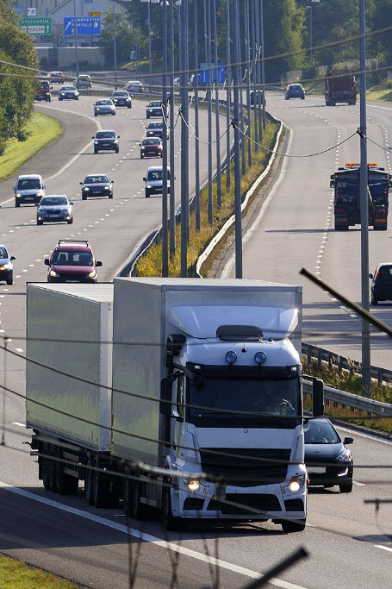
E-services tutorial
- How to report hazardous waste
This is a step-by-step tutorial on reporting hazardous waste to the waste register maintained by the Swedish Environmental Protection Agency.

Slide 2
Copyright notice to imagery
Photographic imagery in this presentation cannot be copied to or used in other presentations.
The copyright only applies to this presentation.

Slide 3
Step 1 log in

Slide 4
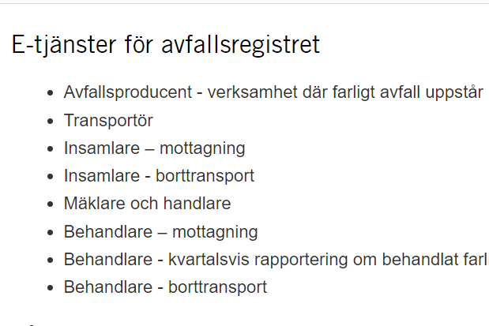
www.naturvardsverket.se/avfallsregister
(e-services for the waste register)
The easiest way to access the waste register is via:
www.naturvardsverket.se/
avfallsregister
Select the entry:
”Transportör”
”Carrier”

Slide 5

To access the e-service
To complete the login and access the e-service, you need to identify yourself with an e-identification.

Slide 6
Step 2 first questions

Slide 7
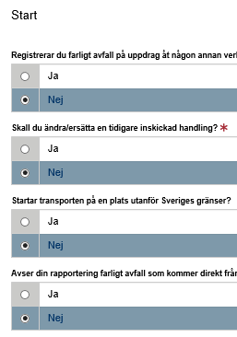
Start=First
The first step is to submit answers to identify if
you are reporting as an agent
want to change a previously submitted document.
the transport starts outside the Swedish border or
hazardous waste comes directly from households
An agent is authorized to bring an action for another person.

Slide 8
Step 3 contact details

Slide 9
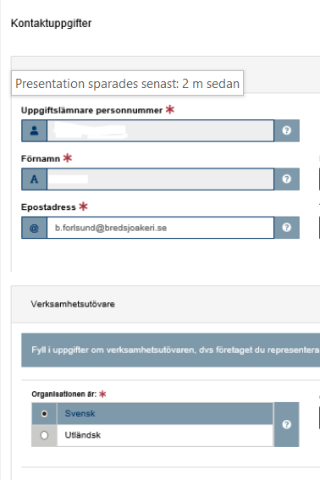
Contact details
Some details about you is filled in automatically and can’t be changed.
Submit details about the company/business you represent.
See example on next page.

Slide 10

Example with contact details
Uppgiftslämnare (Provider)
Uppgiftslämnares personnummer: * Provider’s social security number
19850117-4448
Förnamn: * First name
Operators in this note are carrier’s of hazardous waste. In other notes, operators are producers of hazardous waste, performers who professionally collect or treat hazardous waste, or act as dealers and brokers of hazardous waste
Efternamn: * Surname
Benjamin
Forslund
E-postadress: * E-mail
Telefonnummer: * Telephone
b.forslund@bredsjoakeri.se
073-587 42 22
Verksamhetsutövare (Operator)
Organisationsnummer/personnummer: *
Organization number/social security number
5525413695
Verksamhetens namn: * Name of the company
Kontaktperson: * Contact person
Bredsjö Åkeri AB
Linda Karlsson
E-postadress: * E-mail
Telefonnummer: * Telephone
linda.karlsson@bredsjoakeri.se
070-584 14 40

Slide 11
Step 4 carrier details

Slide 12
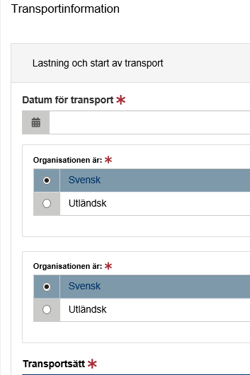
Carrier details
Here, details must be provided in three areas:
Loading and start of transportation
Place of origin of the waste
Destination
Examples on following pages

Slide 13
Provide information: carrier details
- Loading and start of transportation
Lastning och start av transport Loading and start of transportation
Datum för transport: * Date of transport
2020-10-01
The legal person who receives the hazardous waste after transport has been completed.
For example. a waste handler, waste collector
Tidigare innehavare organisationsnummer/personnummer: *
Previous holder’s organization number
568749-9631
Ny innehavare organisationsnummer/personnummer: *
New holder’s organization number
578654-3214
Transportsätt: * Transportation
Vägtransport

Slide 14

Provide information: carrier details
- Place for start of transport. Option 1 if address exists
Postadress: * Postal address
Virkesvägen 2
Postnummer: * Zip code
Postort: * Post office
120 30
Stockholm
Kommun: * Municipality
Stockholm (0180)

Slide 15

Provide information: carrier details
- Place for start of transport. Option 2 if address is missing - enter coordinates
Nordkoordinat (SWEREF 99 TM):*
North coordinate
Ostkoordinat (SWEREF 99 TM):*
East coordinate
5912938
18283472
Beskrivning: Description
Kommun: * Municipality
Stockholm (0180)

Slide 16
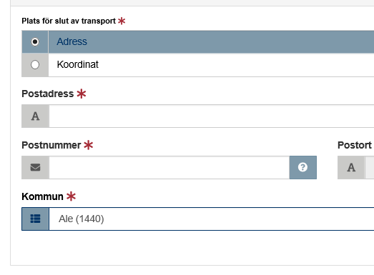
Provide information: carrier details
- Destination. Select option 1 if the address is available.
Enter address if available.
Select option two, enter coordinates if address is not available.

Slide 17
Step 5 waste details

Slide 18
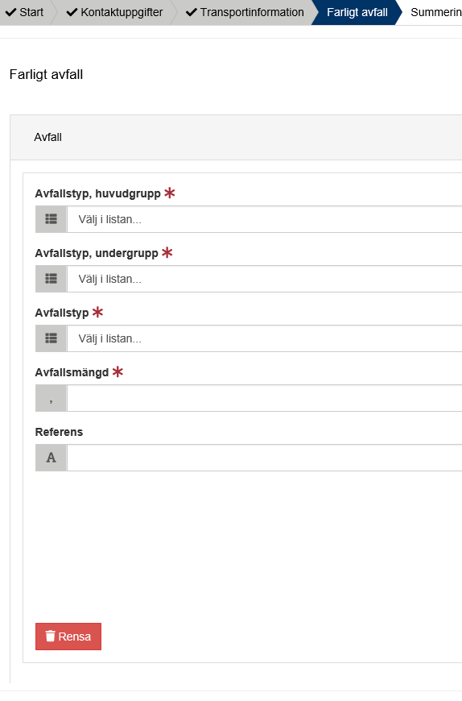
Hazardous waste
All details about the waste must be provided, such as the waste classification code and the amount of waste.
See example on next page.

Slide 19
Example of hazardous waste details
The waste classification codes are from the Waste Regulation (2020: 614) Read an introduction to waste classification
Farligt avfall, avfall Hazardous waste, waste
Avfallstyp, huvudgrupp: * Waste classification code, main group
08 Avfall från tillverkning, formulering, distribution och användning av ytbeläggningar (färg, lack och porslinsemalj), lim, …
Avfallstyp, undergrupp: * Waste classification code, sub group
0801 Avfall från tillverkning, formulering, distribution, användning och borttagning av färg och lack
Avfallstyp: * Waste classification code, six digit code
080111 Färg- och lackavfall som innehåller organiska lösningsmedel eller andra farliga ämnen
Here, the waste transporter can e.g. enter his/her own code for the waste, Free comment.
Avfallsmängd (kg):* Amount of waste in kilogram
KG
100
Referens: Reference
Valfri text

Slide 20
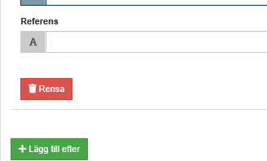
Add more hazardous waste
Select “Lägg till efter“ to add information about other hazardous waste that is transported at the same time.

Slide 21
Step 6 summary & review

Slide 22
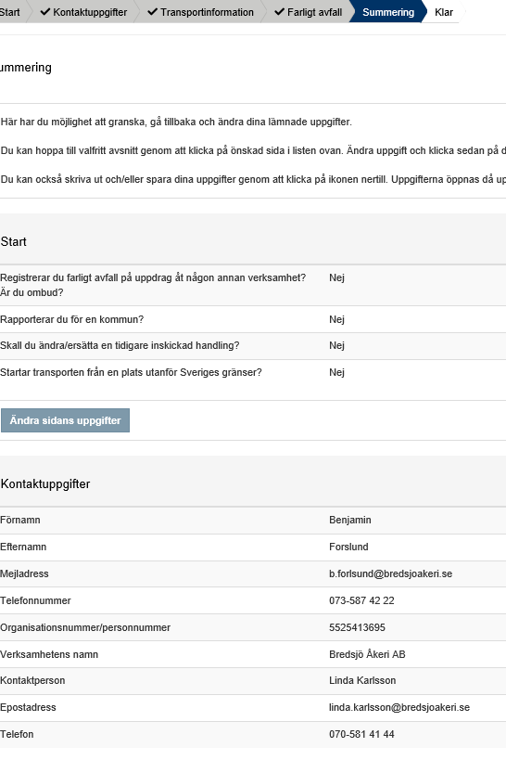
Summary
Review the information.
You can reach different sections to change details by selecting “Ändra sidans uppgifter”.
After changing details in a previous section, you can go directly to this summary.

Slide 23
Step 7 almost done!

Slide 24
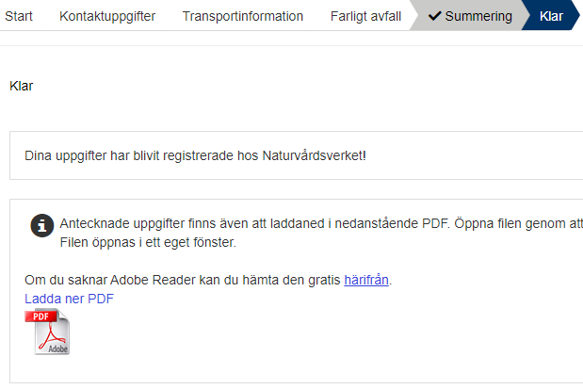
The note is submitted
Thank you for your registration
Keep the registration ID, AvfallsID (found in the pdf file), to be able to revise the registration later.
Log out of the e-service
What happens next? When the carrier has reached the destination site, the waste is checked and measured at the facility. Sometimes analytical samples are taken to find out the components. Thereafter, the waste is treated in accordance to relevant methods.

Slide 25
How do I change an earlier registration?

Slide 26
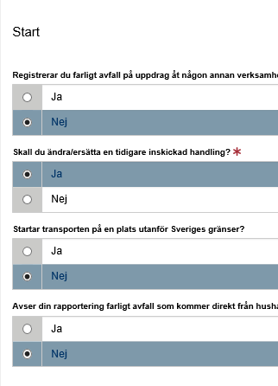
Start
You can edit a submitted note by replacing it. To succeed you need to know the note’s registration ID (avfallsID).
Select “ja“ (yes) at the Start question “Ska du ändra/ersätta en tidigare inskickad handling?”
Enter the former “avfallsID” and enter all correct details
The new note replaces the previous one and gets a new registration ID (avfallsID)
See example on next page.

Slide 27
Example of replacing a previous note
Farligt avfall, avfall Hazardous waste, waste
The waste classification codes are from the Waste Regulation (2020: 614) Read an introduction to waste classification
AvfallsId som ska ändras: * Registration ID to be replaced
055089d1-81c8-4217-9737-aea00685f1f7
Avfallstyp, huvudgrupp: * Waste classification code, main group
08 Avfall från tillverkning, formulering, distribution och användning av ytbeläggningar (färg, lack och porslinsemalj), lim, …
Avfallstyp, undergrupp: * Waste classification code, sub group
0801 Avfall från tillverkning, formulering, distribution, användning och borttagning av färg och lack
Avfallstyp: * Waste classification code, six digit code
080111 Färg- och lackavfall som innehåller organiska lösningsmedel eller andra farliga ämnen
Here, the waste transporter can e.g. enter his/her own code for the waste or other, free comment.
Avfallsmängd (kg): * Amount of waste in kilogram
KG
100
Referens: Reference
Valfri text

